Slide 1
COMP 122/L Lecture 6
Mahdi Ebrahimi Slides adapted from Dr. Kyle Dewey

Slide 2
Assembly

Slide 3
Core Components
Some place to hold the statements as we operate on them
Some place to hold which statement is next
Some place to hold variables
Some way to add numbers

Slide 4
Processors
Amazingly, these are all the core components of a processor
Why is this significant?
Processors just reads a series of statements (instructions) forever.

Slide 5
Core Components
Some place to hold the statements as we operate on them
Some place to hold which statement is next
Some place to hold variables
Some way to add numbers

Slide 6
Core Components
Some place to hold the statements as we operate on them - memory
Some place to hold which statement is next -
program counter
Some place to hold variables - registers
Behave just like variables with fixed names
Some way to add numbers – arithmetic logic unit (ALU)
Some place to hold which statement is currently being executed – instruction register (IR)

Slide 7
Basic Interaction
Copy instruction from memory at wherever the program counter says into the instruction register
Execute it, possibly involving registers and the arithmetic logic unit
Update the program counter to point to the next instruction
Repeat

Slide 8
Basic Interaction
initialize(); while (true) {
instruction_register = memory[program_counter];
execute(instruction_register); program_counter++;
}
-initialize() will load in the initial state, and put instructions in memory
-execute(instruction_register) will read the instruction and do what it says, potentially looking at registers, assigning things to registers, and using the arithmetic logic unit
-Have this handy while going through next animation

Slide 9
ARM
https://en.wikipedia.org/wiki/ARM_architecture
Notes:
ARM: Advanced RISC Machine, originally Acorn RISC Machine
Reduced Instruction Set Computer, or RISC (/rɪsk/),

Slide 10
Why ARM?
Incredibly popular in embedded devices
Much simpler than Intel processors
-Embedded devices include things like phones and microwaves.
-Your computer may have an ARM processor in it even though the “main” processor is from Intel
Notes:
ARM: Advanced RISC Machine, originally Acorn RISC Machine
Reduced Instruction Set Computer, or RISC (/rɪsk/),

Slide 11
Code on ARM
Original
ARM
x = 5;
y = 7;
z = x + y;
mov | r0, | #5
mov | r1, | #7
add | r2, | r0, | r1

Slide 12
Code on ARM
Original
ARM
mov | r0, | #5
mov | r1, | #7
add | r2, | r0, | r1
x = 5;
y = 7;
z = x + y;
move: put the given value into a register
r0: register 0

Slide 13
Code on ARM
Original
ARM
mov | r0, | #5
mov | r1, | #7
add | r2, | r0, | r1
x = 5;
y = 7;
z = x + y;
move: put the given value into a register
r1: register 1

Slide 14
Code on ARM
Original
ARM
mov | r0, | #5
mov | r1, | #7
add | r2, | r0, | r1
x = 5;
y = 7;
z = x + y;
add: add the rightmost registers, putting the result in the first register
r2: register 2

Slide 15
Available Registers
17 registers in all
16 “general-purpose”
1 “special-purpose”
For the moment, we will only consider registers r0 - r12
-General purpose: can put values in them and take values out as I please
-Special purpose: holding certain flags. Can manipulate this, but not in the same way as a general-purpose register

Slide 16
Assembly
The code that you see below is ARM assembly
Assembly is *almost* what the machine sees. For the most part, it is a direct translation to binary from here (known as machine code)
mov | r0, | #5
mov | r1, | #7
add | r2, | r0, | r1
-More on why I said “the most part” later. Psuedo instructions are translated to other instructions. Branches also need calculation to occur (for labels), and there are caveats about the instruction immediately after a branch

Slide 17

Workflow
Assembly
mov mov add | r0, r1, r2, | #5 #7 r0, | r1
Assembler (analogous to a compiler)
Machine Code
001101....

Slide 18
Machine Code
This is what the process actually executes and accepts as input
Each instruction is represented with 32 bits
add r2, r0, r1
-Converting to machine code is mostly one-to-one: just put the right bits in the right places
-There are some exceptions where we have to be a bit smarter, but not much smarter. Assemblers are nowhere near as complex as compilers.

Slide 19
Adding More Functionality
We need a way to display the result
What does this entail?
-Actually quite the tall order

Slide 20
Adding More Functionality
We need a way to display the result
What does this entail?
Input / output. This entails talking to devices, which the operating system handles
We need a way to tell the operating system to kick in
-Actually quite the tall order

Slide 21
Talking to the OS
We are going to be running on an ARM simulator, ARMSim#
We cannot directly access system libraries (they aren’t even in the same machine language)
How might we print something?

Slide 22
ARMSim# Routines
ARM features a swi instruction, which triggers a software interrupt
Outside of a simulator, these pause the program and tell the OS to check something
Inside the simulator, it tells the simulator to check something
Notes:
SWI stands for Software Interrupt. In RISC OS SWIs are used to access Operating System routines or modules produced by a 3rd party.

Slide 23
swi
So we have the OS/simulator’s attention. But how does it know what we want?

Slide 24
swi
So we have the OS/simulator’s attention. But how does it know what we want?
swi operand: integer saying what to do
The OS/simulator can also read the registers to get extra information as needed
-”Integer saying what to do”: e.g., we agree that “5” means “print something”
-With reading the registers, these could include exactly what to print

Slide 25
(Finally) Printing an Integer
For ARMSim#, the integer that says “print an integer” is 0x6B
Register r1 holds the integer to print
Register r0 holds where to print it; 1
means “print to standard output (screen)”
-Other SPIM utilities available via syscall: https://www.doc.ic.ac.uk/lab/secondyear/spim/ node8.html

Slide 26
Augmenting with Printing
mov mov add | r0, r1, r2, | #5 #7 r0, | r1
mov | r1, | r2 | ; | r1: integer to print
mov swi | r0, 0x6B | #1 | ; ; | r0: where to print it 0x6B: print integer

Slide 27
Exiting
If you are using ARMSim#, then you need to say when you are done as well
How might this be done?

Slide 28
Exiting
If you are using ARMSim#, then you need to say when you are done as well
How might this be done?
swi with a particular operand (specifically 0x11)

Slide 29
Augmenting with Exiting
mov mov add | r0, r1, r2, | #5 #7 r0, | r1
mov | r1, | r2 | ; | r1: integer to print
mov swi | r0, 0x6B | #1 | ; ; | r0: where to print it 0x6B: print integer
swi | 0x11 | ; |  | 0x11: | exit | program

Slide 30
Making it a Full Program
Everything is just a bunch of bits
We need to tell the assembler which bits should be placed where in memory

Slide 31
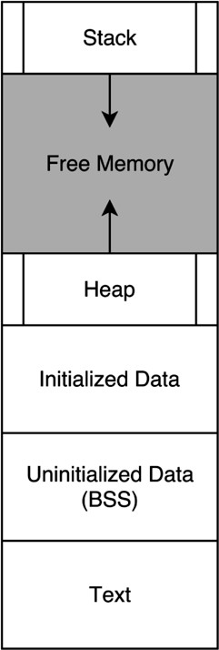
-Image source: https://en.wikipedia.org/wiki/Data_segment
-Representation of a program in memory
-What do you recognize?

Slide 32
Allocated as Program Runs
-Image source: https://en.wikipedia.org/wiki/Data_segment
-You’ve seen these two before
-What might the rest be?

Slide 33

Everything Below is Allocated at Program Load
Allocated as Program Runs
Constants (e.g., strings)
Mutable Global Variables
Code
-Image source: https://en.wikipedia.org/wiki/Data_segment

Slide 34
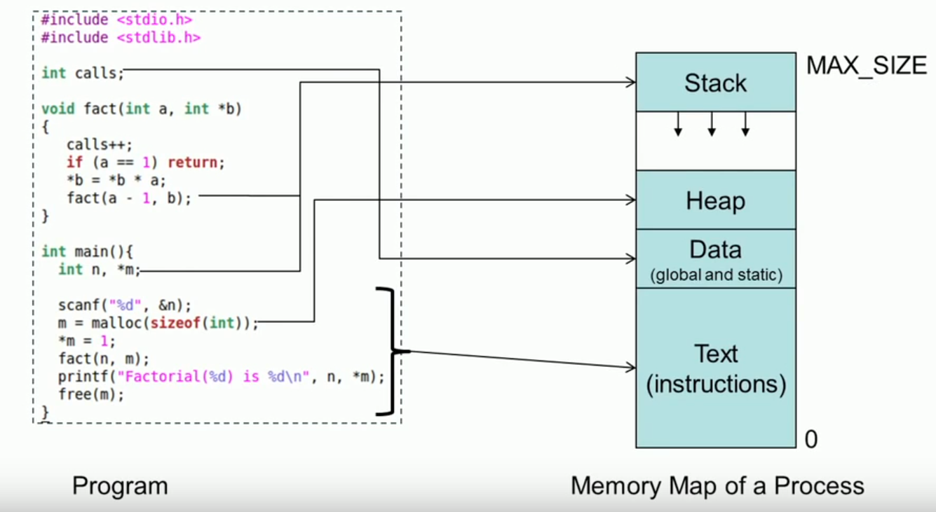
Process Memory Map

Slide 35
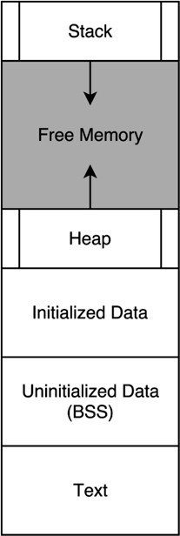
Marking Code
Use a .text directive to specify code section
.text
mov mov add mov | r0, r1, r2, r1, | #5 #7 r0, r1 r2
mov swi | r0, 0x6B | #1
swi | 0x11
-Directives tell the assembler to do something

Slide 36
Marking Code
Use a .data directive to specify data section
.data string1:
.asciz “hello” string2:
.asciz “bye”
-Directives tell the assembler to do something

